Slide 1
Chapter 16 Employee Stock Options

Slide 2
Nature of Employee Stock Options
Employee stock options are call options issued by a company on its own stock
They are often at-the-money at the time of issue
They often last as long as 10 years

Slide 3
Typical Features of Employee Stock Options (page 355)
There is a vesting period during which options cannot be exercised
When employees leave during the vesting period options are forfeited
When employees leave after the vesting period in-the-money options are exercised immediately and out of the money options are forfeited
Employees are not permitted to sell options
When options are exercised the company issues new shares

Slide 4
Exercise Decision
To realize cash from an employee stock option the employee must exercise the options and sell the underlying shares
Even when the underlying stock pays no dividend an employee stock option (unlike a regular call option) is often exercised early

Slide 5
Drawbacks of Employee Stock Options
Gain to executives from good performance is much greater than the penalty for bad performance
Executives do very well when the stock market as a whole goes up, even if their firm does relatively poorly
Executives are encouraged to focus on short-term performance at the expense of long-term performance
Executives are tempted to time announcements or take other decisions that maximize the value of the options

Slide 6
Accounting for Employee Stock Options
Prior to 1995 the cost of an employee stock option on the income statement was its intrinsic value on the issue date
After 1995 a “fair value” had to be reported in the notes (but expensing fair value on the income statement was optional)
Since 2005 both FASB and IASB have required the fair value of options to be charged against income at the time of issue

Slide 7
Traditional At-the-Money Call Options
The attraction of at-the-money call options used to be that they led to no expense on the income statement because they had zero intrinsic value on the exercise date
Other plans were liable to lead an expense
Now that the accounting rules have changed some companies are considering other types of plans

Slide 8
Nontraditional Plans page 358
Strike price is linked to stock index so that the company’s stock price has to outperform the index for options to move in the money
Strike price increases in a predetermined way
Options vest only if specified profit targets are met

Slide 9
Valuation of Employee Stock Options
Most common approach is to use Black-Scholes-Merton with time to maturity equal to an estimate of expected life
There is no theoretical justification for this but it seems to give reasonable results in most circumstances

Slide 10
Example (Example 16.1, page 359)
A company issues one million10-year ATM options
stock price is $30.
It estimates the long term volatility using historical data to be 25% and the average time to exercise to be 4.5 years
The 4.5 year interest rate is 5% and dividends during the next 4.5 years are estimated to have a PV of $4
Using BSM with S₀ =30, K=30, r=5%, σ=25%, and T=4.5 years gives value of each option equal to $6.31
The income statement expense would be $6.31 million

Slide 11
Other Approaches
Estimate the probability of exercise as a function of the stock price and remaining life. Use a binomial tree with roll back rules reflecting the probabilities
A simple version of this is to assume that the option is exercised when the ratio of the stock price to the strike price reaches some multiple
Use an auction to determine the market prices of securities whose payoffs mirror the payoffs from the options
This is an approach used by Zions Bancorp in 2007

Slide 12
Dilution
Employee stock options are liable to dilute the interests of shareholders because new shares are bought at below market price
However this dilution takes place at the time the market hears that the options have been granted (Business Snapshot 15.3)
It does not take place at the time the options are exercised

Slide 13
Backdating
Backdating appears to have been a widespread practice in the United States
A company might take the decision to issue at-the-money options on April 30 when the stock price is $50 and then backdate the grant date to April 3 when the stock price is $42
Why would they do this?

Slide 14
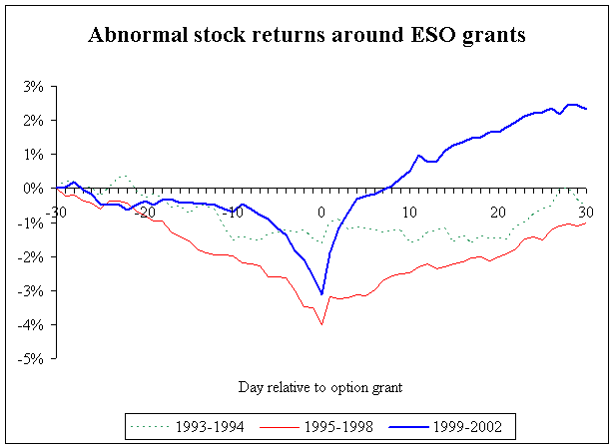
Academic Research Exposed Backdating (See Eric Lie’s web site: www.biz.uiowa.edu/faculty/elie/backdating.htm

